Slide 1
TOPIC
APPLICATIONS
CENTROIDS OF PLANE AREA

Slide 2
DISCUSSION
The mass of a physical body is a measure of the quantity of the matter in it,
whereas the volume of the body is a measure of the space it occupies.
If the mass per unit volume is the same throughout the body is said to
be homogeneous or to have constant density.
It is highly desirable in physics and mechanics to consider a given mass
as concentrated at a point, called its center of mass (also, its center of gravity).
For a homogeneous body, this point coincides with its geometric center or
centroid. For example, the center of mass of a homogeneous rubber ball
coincides with the centroid (center) of the ball considered as a geometric
solid (a sphere).
The centroid of a rectangular sheet of paper lies midway between the two
surfaces but it may well be considered as located on one of the surfaces
at the intersection of the two diagonals. Then the center of mass of a thin
sheet coincides with the centroid of the sheet considered as a plane area.

Slide 3
The Moment M_{L} of a Plane Region with respect to a line L is the product of the area and the directed distance of the centroid from the line. The moment of a composite region with respect to a line is the sum of the moments of the individual sub-regions with respect to the line.
The moment of a plane region with respect to a coordinate axis may be found as follows:
1. Sketch the region; showing a representative strip.
2. Form the product of the area of the rectangle and the distance of its
centroid from the axis.
3. Evaluate the definite integral of the product in step 2 and apply the
fundamental theorem.

Slide 4
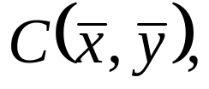
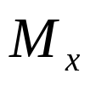
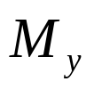
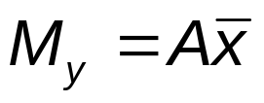

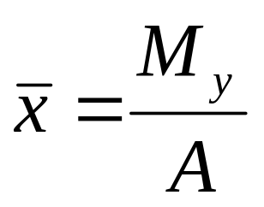
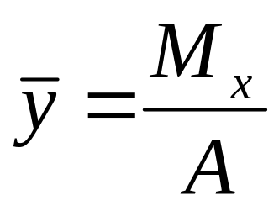
For a plane region having an area A, centroid and moments
and with respect to x and y axes,
and

Slide 5



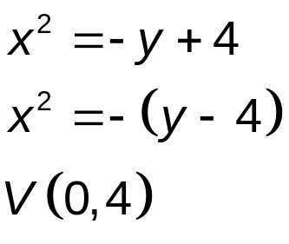

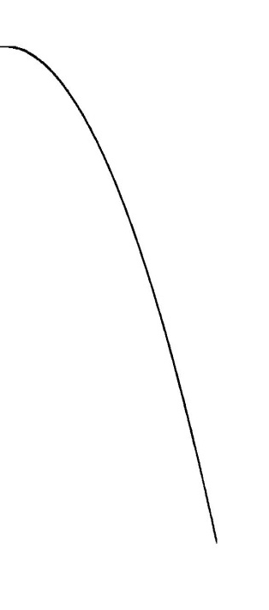
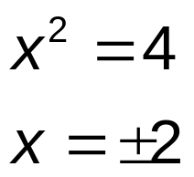



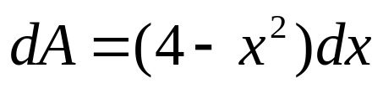

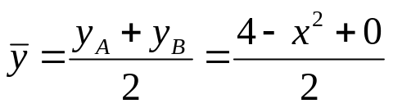
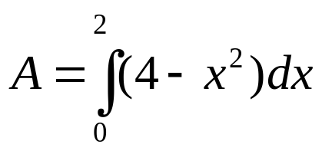
EXAMPLE
.
Determine the centroid of the first-quadrant region bounded by the parabola
Curve:
if
y
V(0,4)
Solving for the area A:
(0,2)
x
dx

Slide 6
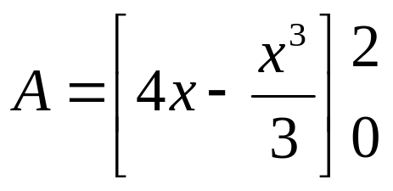
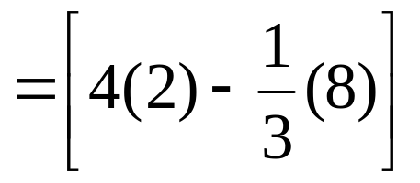
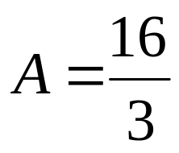
sq. units

Slide 7
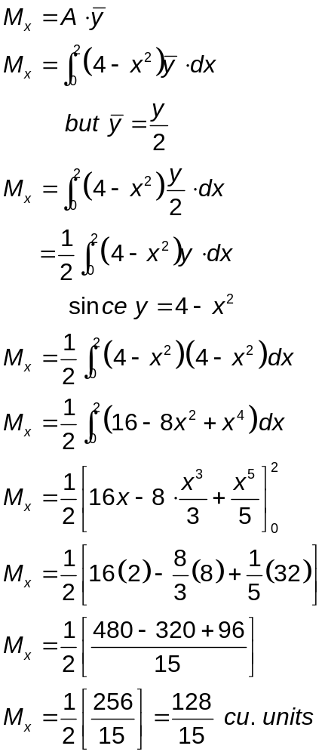
Moment about the x-axis

Slide 8
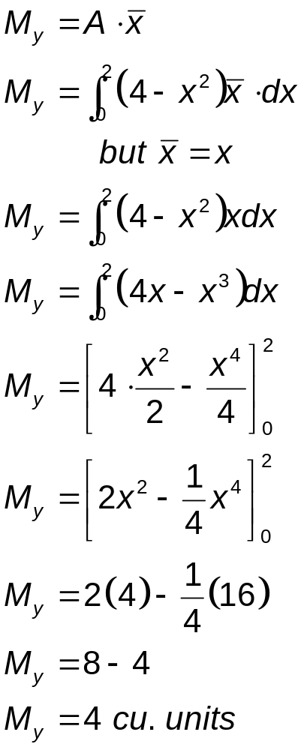
Moment about the y-axis

Slide 9
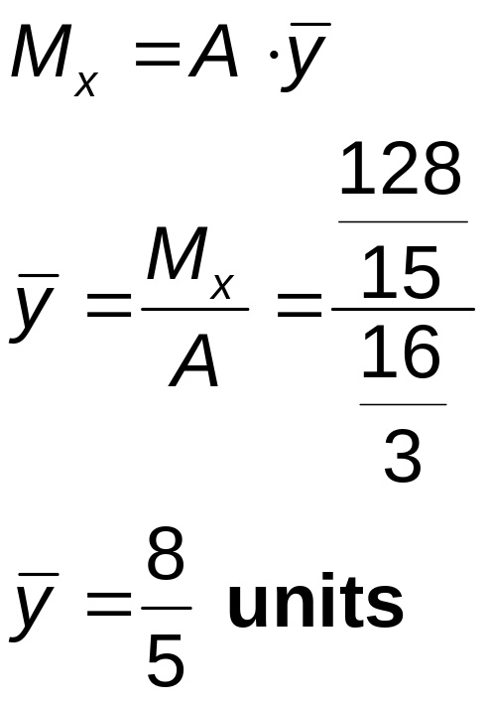
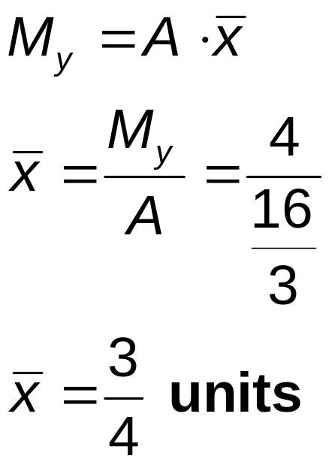
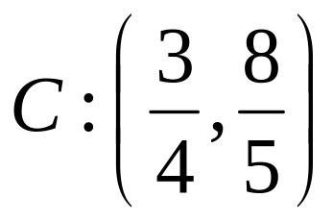

Slide 10

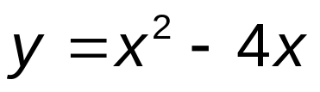
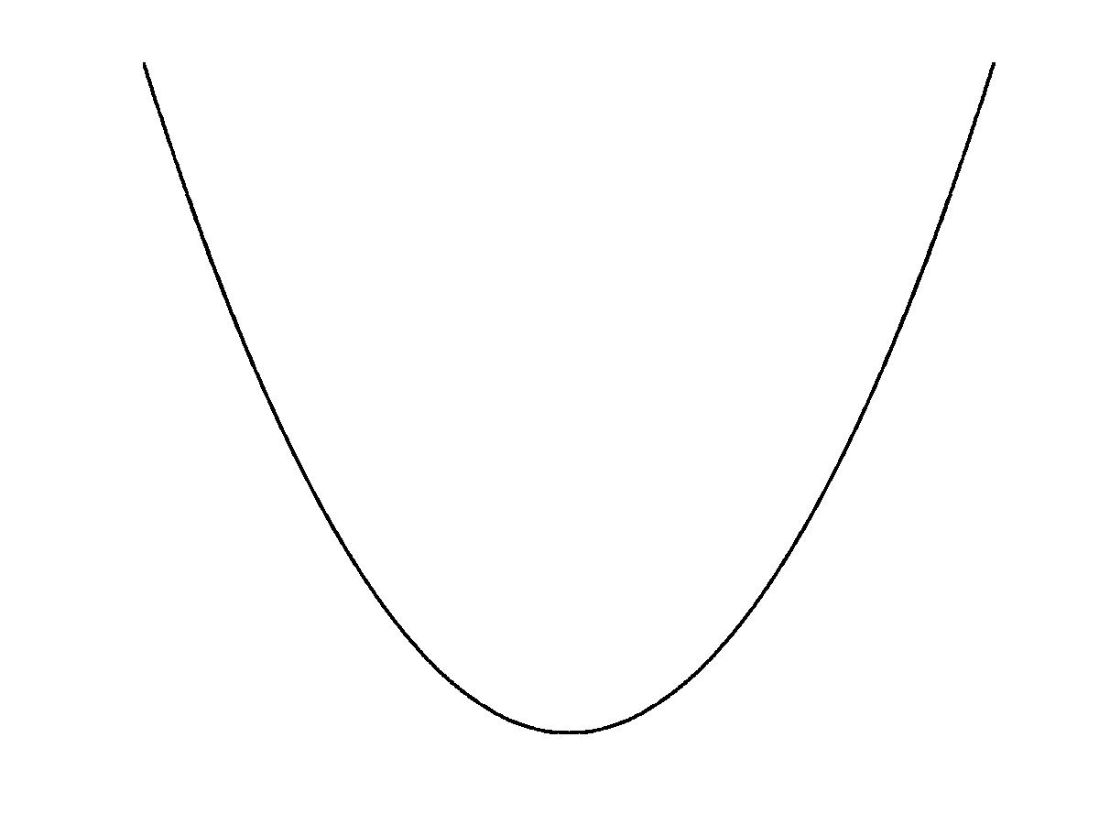
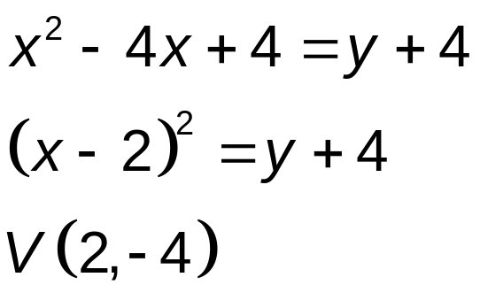
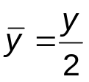

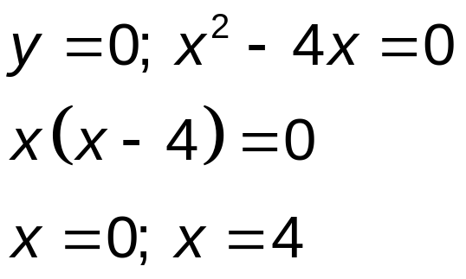


EXAMPLE
Determine the centroid of the fourth-quadrant area bounded by the curve
.
Curve:
y
dx
x
V(2,-4)

Slide 11
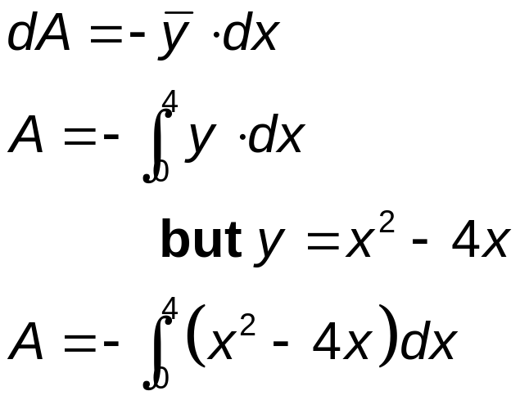
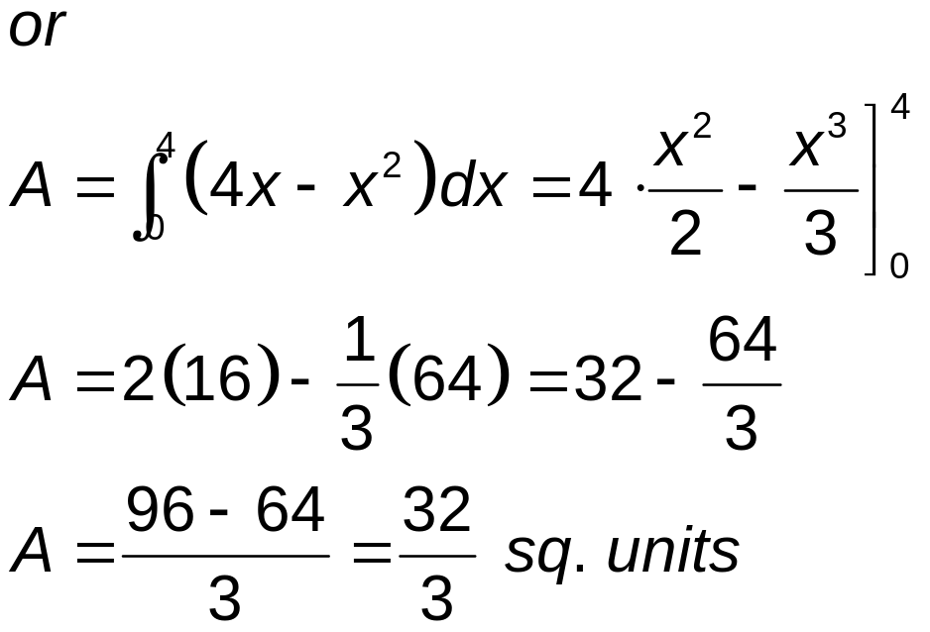
Solving for area A:

Slide 12
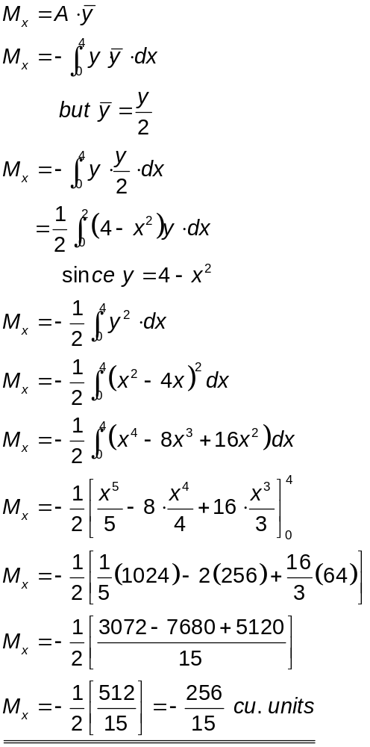
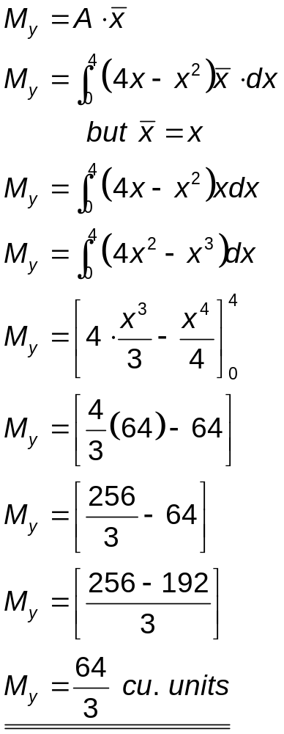

Slide 13
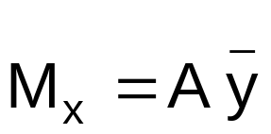
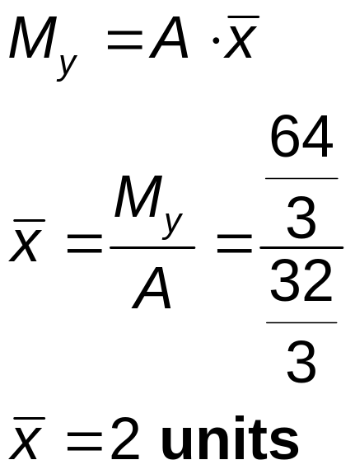
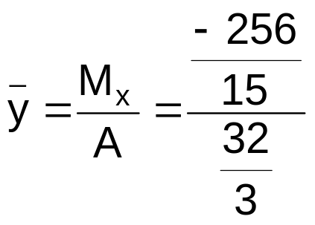
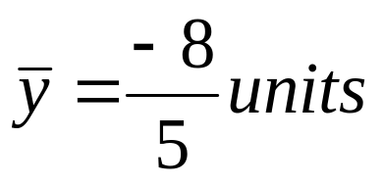
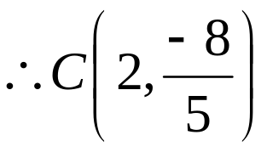

Slide 14
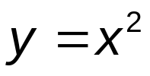



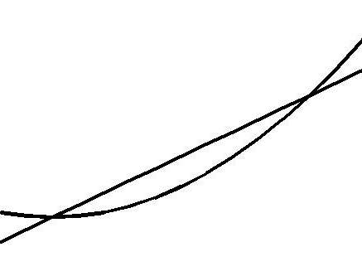


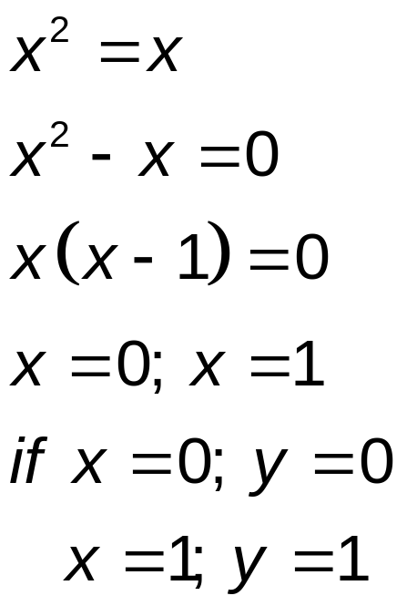
EXAMPLE
Determine the centroid of the region bounded by the curve
and the line .
.
Curve:
y
Line:
(1,1)
Intersection point:
y_{A}-y_{B}
x
dx

Slide 15
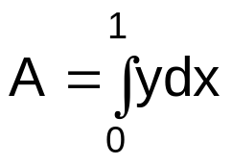
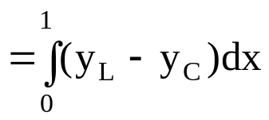
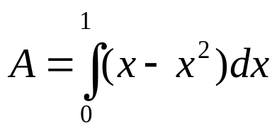
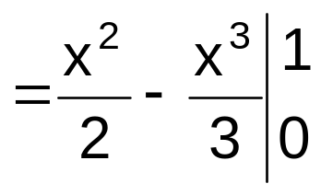
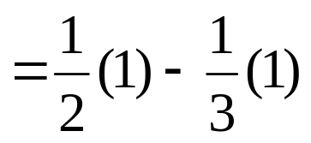
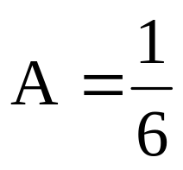
Solving for area A : dA = ydx
but y_{L} = x, y_{C} = x²
square units

Slide 16
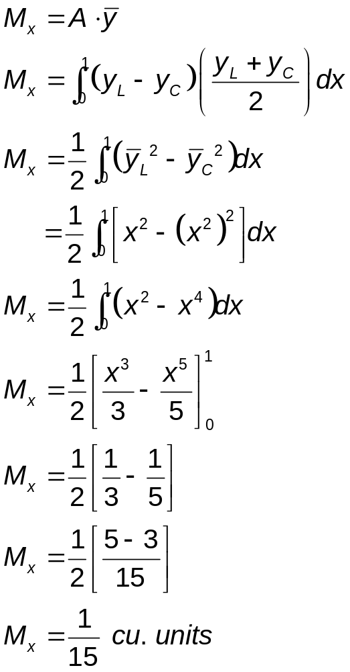
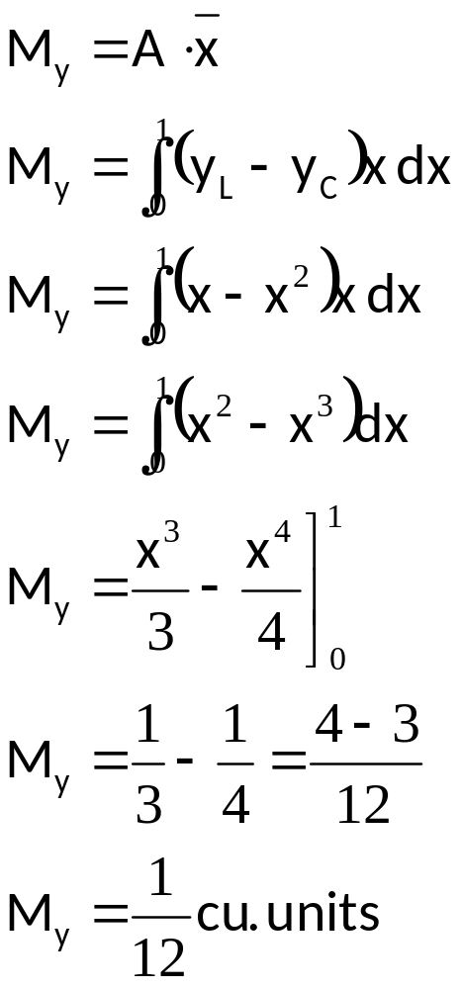

Slide 17
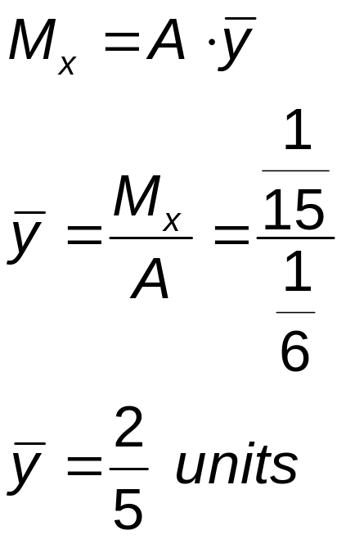
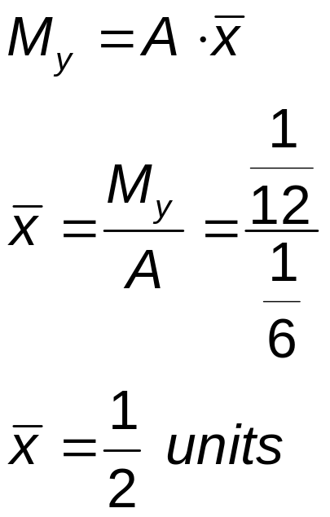
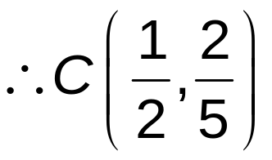

Slide 18





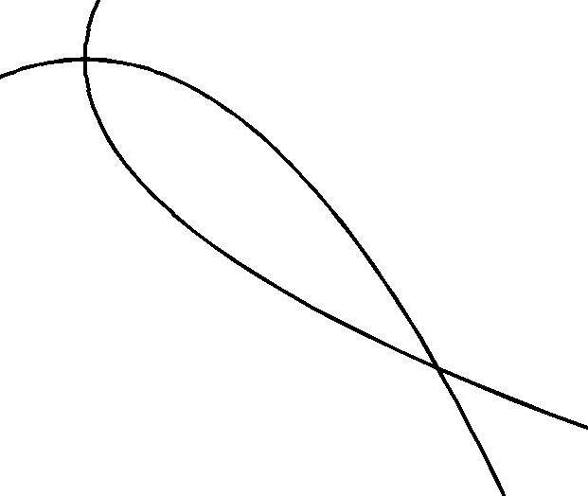

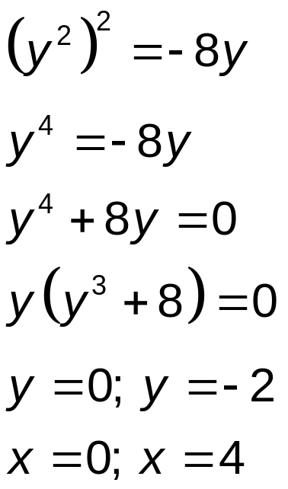



EXAMPLE
Determine the centroid of the area bounded by the parabolas and
.
Curve 1:
y
Curve 2:
x
(x₁,y)
(x₂,y)
dy
Solving for intersection points:
(4,-2)
Therefore, the intersection points are (0, 0) and (4, -2).

Slide 19

Solving for area A:
Continue solving for the centroid

Slide 20
Find the centroid of each of the given plane region bounded by the following curves:
  1. y = 10x – x², the x-axis and the lines x = 2 and x = 5
2. 2x + y = 6, the coordinate axes
3. y = 2x + 1, x + y = 7, x = 8
4. y² = 2x, y = x – 4
5. y = x³, y = 4x [first quadrant]
6. y² = x³, y = 2x
7. y = x² – 4, y = 2x – x²
8. the first quadrant area of the circle x² +y² = a²
9. the region enclosed by b²x² + a²y² = a²b² in the first
quadrant

